Slide 1

UECS3213 / UECS3453 Data Mining Topic 2b: Data Exploration
Dr. Simon Lau Boung Yew

Slide 2
Course Learning Outcomes
CO1: Identify the key technological foundations of data mining
CO2: Create programming solutions using data mining techniques for given problem
CO3: Evaluate performance of data mining solutions for a given problem
CO4: Construct a data mining project as a team
CO5: Recognize the importance of data mining techniques and its applications in the industry

Slide 3
Outline
What is data exploration?
Exploratory Data Analysis (EDA)
Summary Statistics
Visualization
Representation
Arrangement
Selection
Visualization Techniques
Histogram
Box Plot
Scatter Plot
Contour Plot
Matrix Plot
Parallel Coordinates
Star / Radar Plot
Chernoff Faces
OLAP

Slide 4
What is Data Exploration?
A preliminary exploration of the data to better understand its characteristics.
Key motivations of data exploration include
Helping to select the right tool for preprocessing or analysis
Making use of humans’ abilities to recognize patterns
People can recognize patterns not captured by data analysis tools
Related to the area of Exploratory Data Analysis (EDA)
Notes:
Exploratory Data Analysis (EDA): https://en.wikipedia.org/wiki/Exploratory_data_analysis

Slide 5
Exploratory Data Analysis (EDA)
In statistics, exploratory data analysis (EDA) is an approach in analyzing data sets to summarize their main characteristics, often with visual methods.
Created by statistician John Tukey
Seminal book is “Exploratory Data Analysis” by Tukey
A nice online introduction can be found in Chapter 1 of the NIST Engineering Statistics Handbook
http://www.itl.nist.gov/div898/handbook/index.htm

Slide 6
Techniques Used in Data Exploration
Exploratory techniques: Clustering and anomaly detection (Chapter 5)
The focus is on visualization.
In our discussion of data exploration, we focus on
Summary statistics
Visualization

Slide 7
Summary Statistics
Summary statistics are numbers that summarize properties of the data
In descriptive statistics, summary statistics are used to summarize a set of observations, in order to communicate the largest amount of information as simply as possible.
Summarized properties / measures may include
frequency
location or central tendency (e.g. mean)
spread or statistical dispersion / variability (e.g. standard deviation)
Most summary statistics can be calculated in a single pass through the data
Example: http://archive.ics.uci.edu/ml/machine-learning-databases/iris/iris.names
Notes:
https://en.wikipedia.org/wiki/Summary_statistics

Slide 8
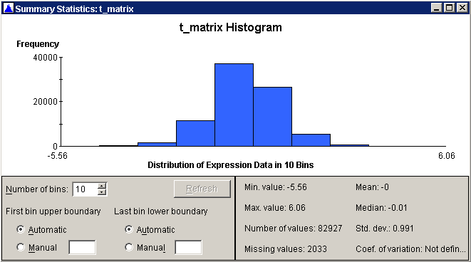
Summary Statistics / Descriptive Statistics
A descriptive statistic is a summary statistic that quantitatively describes or summarizes features of a collection of information.
Descriptive statistics aims to summarize a sample
Notes:
https://en.wikipedia.org/wiki/Descriptive_statistics

Slide 9
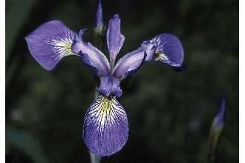
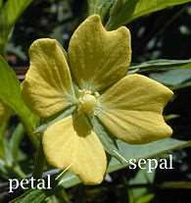
Iris Sample Data Set
Many of the exploratory data techniques are illustrated with the Iris Plant data set.
From the statistician Douglas Fisher. Can be obtained from the UCI Machine Learning Repository
http://www.ics.uci.edu/~mlearn/MLRepository.html
http://archive.ics.uci.edu/ml/datasets/Iris
Three flower types (classes):
Setosa
Virginica
Versicolour
Four (non-class) attributes
Sepal width and length
Petal width and length
Virginica. Robert H. Mohlenbrock. USDA NRCS. 1995. Northeast wetland flora: Field office guide to plant species. Northeast National Technical Center, Chester, PA. Courtesy of USDA NRCS Wetland Science Institute.

Slide 10
Frequency and Mode
The frequency of an attribute value is the percentage of time the value occurs in the data set
For example, given the attribute ‘gender’ and a representative population of people, the gender ‘female’ occurs about 50% of the time.
The mode of a an attribute is the most frequent attribute value
The notions of frequency and mode are typically used with categorical (discrete) data
Notes:
http://www.stat.yale.edu/Courses/1997-98/101/catdat.htm

Slide 11
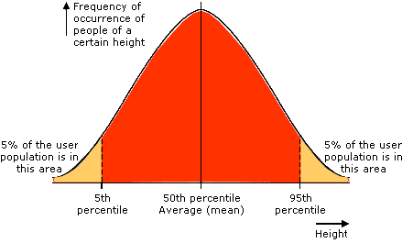
Percentile
For continuous data, the notion of a percentile is more useful.
Given an ordinal or continuous attribute x and a number p between 0 and 100, the p-th percentile is a value x_{p} of x such that p % of the observed values of x are less than x_{p}.
For instance, the 50-th percentile is the value x_{50%} such that 50% of all values of x are less than x_{50%}.
Notes:
https://en.wikipedia.org/wiki/Percentile

Slide 12
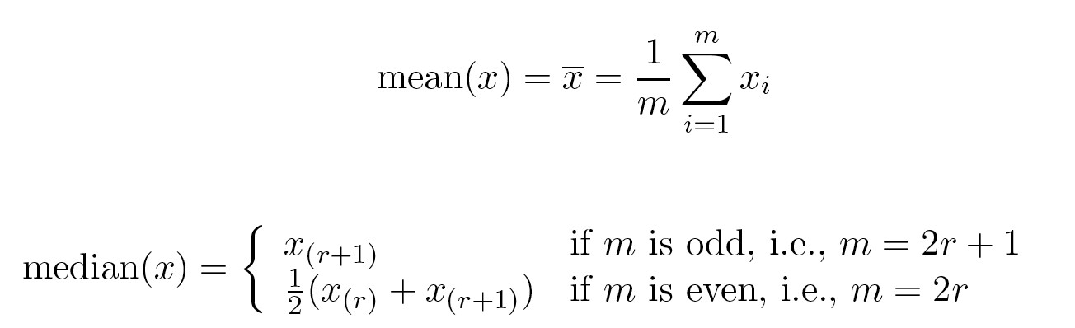
Measure of Location: Mean and Median
The mean is the most common measure of the location of a set of points. However, the mean is very sensitive to outliers.
Thus, the median or a trimmed / truncated mean is also commonly used.
Notes:
https://garstats.wordpress.com/2017/11/28/trimmed-means/
https://www.investopedia.com/terms/t/trimmed_mean.asp
https://en.wikipedia.org/wiki/Truncated_mean

Slide 13
Trimmed / Truncated Mean
It involves trimming α% observations from both ends.
For example, with a α = 5% trimmed mean, the lowest 5% and highest 5% of the data are excluded. The mean is calculated from the remaining 90% of data points.
Interquartile mean = trimmed mean with 25% of data removed from highest and lowest values
Example: Find the trimmed 20% mean for the following test scores: 60, 81, 83, 91, 99.
Trim the top and bottom 20% from the data. That leaves us with the middle three values: 60, 81, 83, 91, 99.
Find the mean with the remaining values. The mean is (81 + 83 + 91) / 3 ) = 85.
More examples: https://mdozmorov.github.io/BIOS567/assets/presentation_Image/Trimmed_mean.pdf
Notes:
https://garstats.wordpress.com/2017/11/28/trimmed-means/
https://www.investopedia.com/terms/t/trimmed_mean.asp
https://en.wikipedia.org/wiki/Truncated_mean
https://mdozmorov.github.io/BIOS567/assets/presentation_Image/Trimmed_mean.pdf

Slide 14
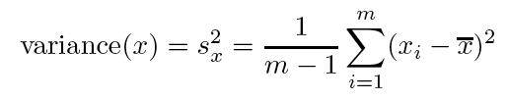
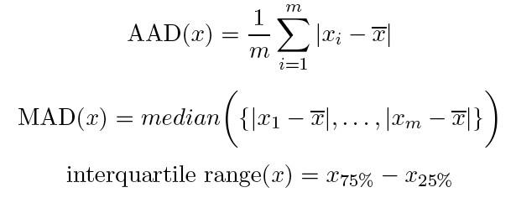
Measures of Spread: Range and Variance
Range is the difference between the max and min.
The variance or standard deviation is the most common measure of the spread of a set of points.
However, this is also sensitive to outliers, so that other measures are often used: AAD, MAD, interquartile range

Slide 15
Average (or Mean) Absolute Deviation (AAD)
The average absolute deviation (or mean absolute deviation) of a data set is the average of the absolute deviations from a central point.
The mean absolute deviation of a set {x₁, x₂, ..., x_{n}} is
The absolute deviation is considered to be more accurate for real-life situations than Standard Deviation
Notes:
https://en.wikipedia.org/wiki/Average_absolute_deviation
https://www.statisticshowto.datasciencecentral.com/average-deviation/

Slide 16
Median Absolute Deviation (MAD)
For a univariate data set X₁, X₂, ..., X_{n}, the MAD is defined as the median of the absolute deviations from the data's median
Notes:
https://en.wikipedia.org/wiki/Median_absolute_deviation

Slide 17
Interquartile Range
In descriptive statistics, the interquartile range (IQR), (also called the midspread or middle 50%, or H-spread), is a measure of statistical dispersion, being equal to the difference between 75th and 25th percentiles, or between upper and lower quartiles, IQR = Q₃ − Q₁
Notes:
https://en.wikipedia.org/wiki/Interquartile_range

Slide 18
IQR Example

Slide 19
Visualization
Visualization is the conversion of data into a visual (charts) or tabular format so that the characteristics of the data and the relationships among data items or attributes can be analyzed or reported.
Visualization of data is one of the most powerful and appealing techniques for data exploration.
Humans have a well developed ability to analyze large amounts of information that is presented visually
Can detect general patterns and trends
Can detect outliers and unusual patterns

Slide 20
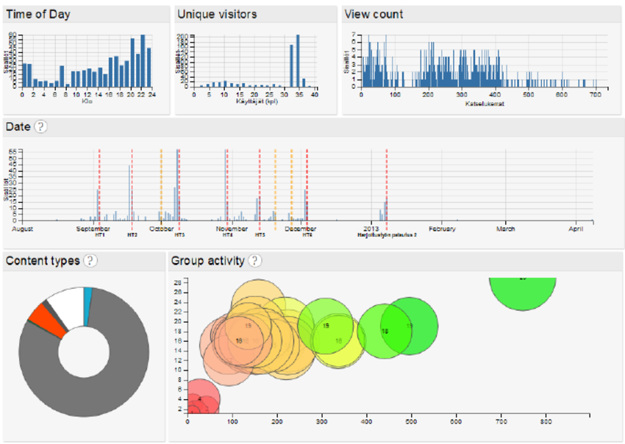
Visualization Examples
Dashboard of charts and graphs

Slide 21
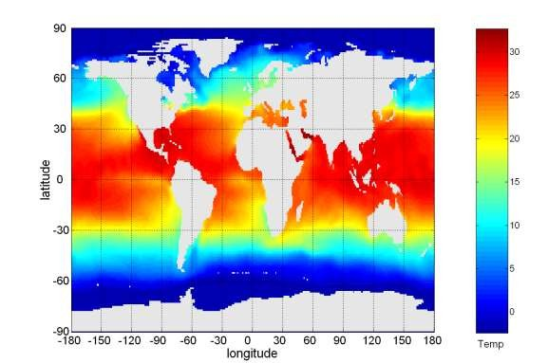
Example: Sea Surface Temperature
The following shows the Sea Surface Temperature (SST) for July 1982
Tens of thousands of data points are summarized in a single figure.

Slide 22
Representation
Representation is the mapping of information to a visual format.
Data objects, their attributes, and the relationships among data objects are translated into graphical elements such as points, lines, shapes, and colors.
Example:
Objects are often represented as points.
Their attribute values can be represented as the position of the points or the characteristics of the points, e.g. color, size, and shape
If (spatial) position is used, then the relationships of points, i.e., whether they form groups or a point is an outlier, is easily perceived via their distance of separation.

Slide 23
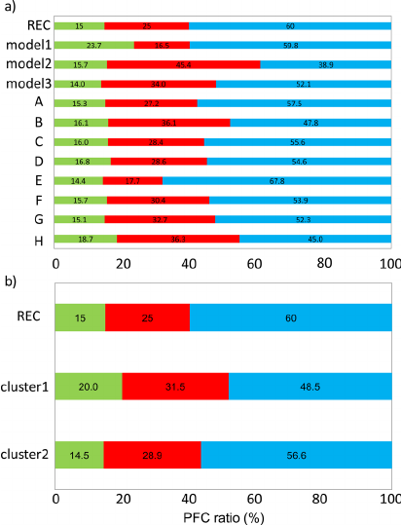
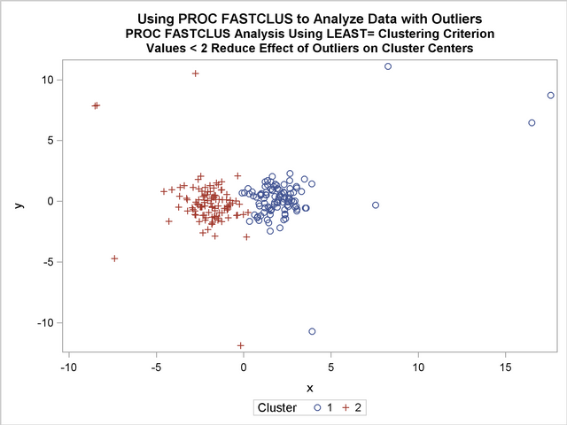
Representation: Examples

Slide 24
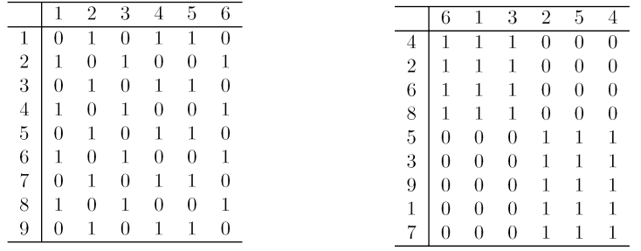
Arrangement
Is the placement of visual elements within a display.
Can make a large difference in how easy it is to understand the data
Example:
=

Slide 25
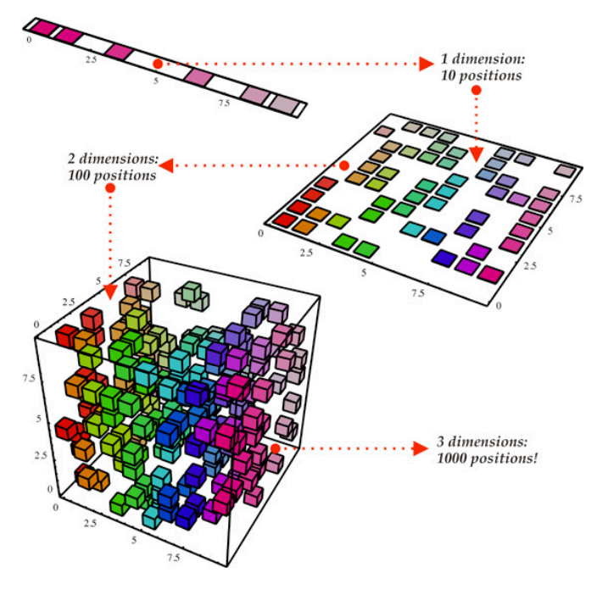
Selection (Reduction)
Selection is the elimination or the de-emphasis of certain objects and attributes. Selection may involve the choosing a subset of attributes.
Dimensionality reduction is often used to reduce the number of dimensions to two or three
Selection may also involve choosing a subset of objects.
A region of the screen can only show so many points
Can sample, but want to preserve points in sparse areas
Notes:
Dimensionality reduction: https://en.wikipedia.org/wiki/Dimensionality_reduction
https://www.geeksforgeeks.org/dimensionality-reduction/

Slide 26
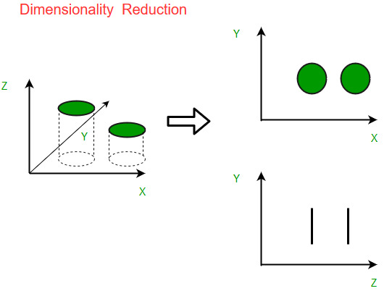
Dimensionality Reduction
Tid | Refund | Marital Status | Taxable Income | Cheat
1 | Yes | Single | 125K | No
2 | No | Married | 100K | No
3 | No | Single | 70K | No
4 | Yes | Married | 120K | No
5 | No | Divorced | 95K | Yes
6 | No | Married | 60K | No
7 | Yes | Divorced | 220K | No
8 | No | Single | 85K | Yes
9 | No | Married | 75K | No
10 | No | Single | 90K | Yes
In classification problems, there are often too many factors (variables called “features”) on the basis of which the final classification is done. The higher the number of features, the harder it gets to visualize the training set and then work on it.
Sometimes, most of these features are correlated, and hence are redundant.
Definition: Dimensionality reduction is the process of reducing the number of random variables (“features”) under consideration, by obtaining a set of principal variables.
It can be divided into feature selection and feature extraction.

Slide 27
Dimensionality Reduction
Many high dimensional datasets:
Gene expression microarrays
Text documents
digital images
SNP data
Clinical data
Bad news: Learning is very hard in high dimensional data, especially when
n (data point) < d (dimensions)
Good news: No way any real-world data can be distributed uniformly in a high dimensional space. There should be an intrinsic dimensionality that is much smaller than the embedding dimensionality!

Slide 28
Dimensionality Reduction
Feature selection: select a subset of the original feature set, to get a smaller subset which can be used to model the problem (e.g. 5 features --> 2 features)
Feature extraction: build a new set of features from the original feature set. Examples of feature extraction: extraction of contours in images, extraction of digrams from a text, extraction of phonemes from recording of spoken text, etc.
Feature extraction involves a transformation of the features, which often is not reversible because some information is lost in the process of dimensionality reduction.
Notes:
https://medium.com/@mehulved1503/feature-selection-and-feature-extraction-in-machine-learning-an-overview-57891c595e96
http://vision.psych.umn.edu/users/schrater/schrater_lab/courses/PattRecog09/Lec17PattRec09.pdf
https://elitedatascience.com/dimensionality-reduction-algorithms

Slide 29
Dimensionality Reduction
Feature selection:
Filter: Rank each feature according to some univariatemetric and select the highest ranking features.
Wrapper: Search for the “best” subset of features (assess using a specific classification algorithm)
Embedded: Feature selection is part of the model building, e.g. decision tree
Markov Blanket
Feature extraction/construction:
Clustering
PCA
SVD
MDS (multidimensional scaling)
Kernel PCA
Notes:
http://people.cs.pitt.edu/~iyad/DR.pdf

Slide 30
Problems of learning in high dimensional spaces
Curse of dimensionality (all points become equal distance) => distance functions are not useful => problem for clustering, KNN,...
Classification overfitting (too many parameter to set!).
High computational costs.
Bad learning behavior in high dimensional spaces.

Slide 31
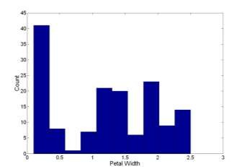
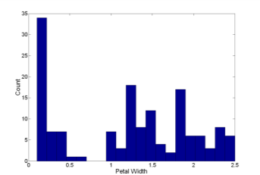
Visualization Techniques: Histograms
Usually shows the distribution of values of a single variable
Divide the values into bins and show a bar plot of the number of objects in each bin.
The height of each bar indicates the number of objects.
Shape of histogram depends on the number of bins.
Example: Petal Width (10 and 20 bins, respectively)
Notes:
https://statistics.laerd.com/statistical-guides/understanding-histograms.php
How to:
https://www.khanacademy.org/math/ap-statistics/quantitative-data-ap/histograms-stem-leaf/v/histograms-intro
https://www.moresteam.com/toolbox/histogram.cfm

Slide 32
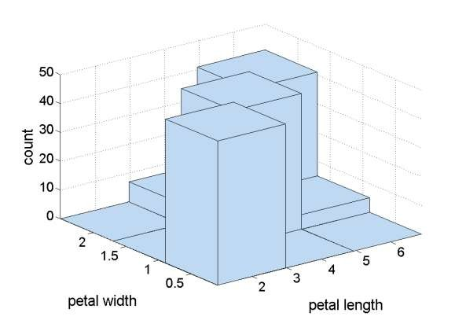
Two-Dimensional Histograms
A two dimensional histogram consists of a set of bins which count the number of events falling in a given area of the (x,y) plane (bin).
The simplest way to use a two dimensional histogram is to record two-dimensional position information, n(x,y). Another possibility is to form a joint distribution by recording related variables.
Example: petal width and petal length
Notes:
https://www.gnu.org/software/gsl/manual/html_node/Two-dimensional-histograms.html

Slide 33
Visualization Techniques: Box Plot / Box-and-Whisker Plot
In descriptive statistics, a box plot or box-and-whisker plot is a method for graphically depicting groups of numerical data through their quartiles and percentiles.
For many computations in statistics, it is assumed that your data points (that is, the numbers in your list) are clustered around some central value.
The "box" in the box-and-whisker plot highlights the middle portion of these data points: 25th (Q1), 50th (median) (Q2) and 75th (Q3) percentiles
Notes:
https://en.wikipedia.org/wiki/Box_plot
How to:
https://www.khanacademy.org/math/probability/data-distributions-a1/box--whisker-plots-a1/v/constructing-a-box-and-whisker-plot
https://www.purplemath.com/modules/boxwhisk.htm

Slide 34
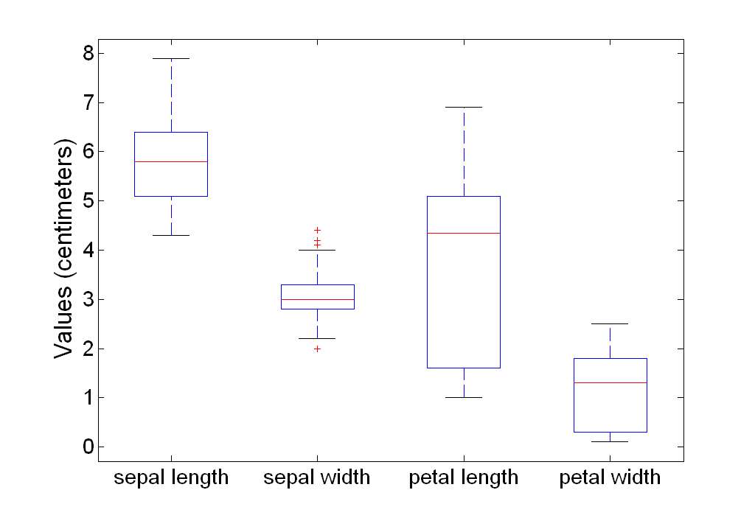
Box Plots: Example
Box plots can be used to compare attributes

Slide 35
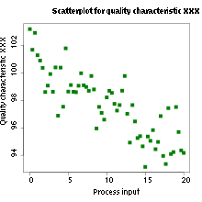
Visualization Techniques: Scatter Plots
Attributes values determine the position.
Two-dimensional scatter plots are most common, but can have three-dimensional scatter plots
Often additional attributes can be displayed by using the size, shape, and color of the markers that represent the objects
It is useful to have arrays of scatter plots can compactly summarize the relationships of several pairs of attributes
Notes:
https://en.wikipedia.org/wiki/Scatter_plot
How to:
https://www.excel-easy.com/examples/scatter-chart.html
https://www.khanacademy.org/math/ap-statistics/bivariate-data-ap/scatterplots-correlation/v/constructing-scatter-plot

Slide 36
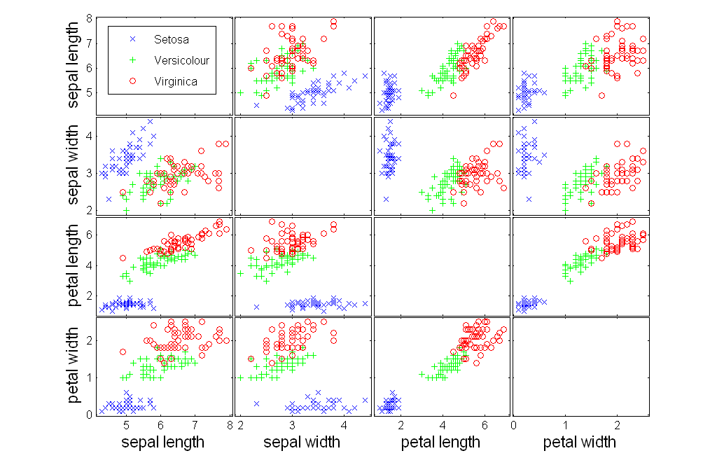
Scatter Plot Array of Iris Attributes

Slide 37
Visualization Techniques: Contour plots
Useful when a continuous attribute is measured on a spatial grid
They partition the plane into regions of similar values
The contour lines that form the boundaries of these regions connect points with equal values
The most common example is contour maps of elevation
Can also display temperature, rainfall, air pressure, etc.
An example for Sea Surface Temperature (SST) is provided on the next slide
Notes:
https://en.wikipedia.org/wiki/Contour_line
How to:
https://www.khanacademy.org/math/multivariable-calculus/thinking-about-multivariable-function/visualizing-scalar-valued-functions/v/contour-plots

Slide 38
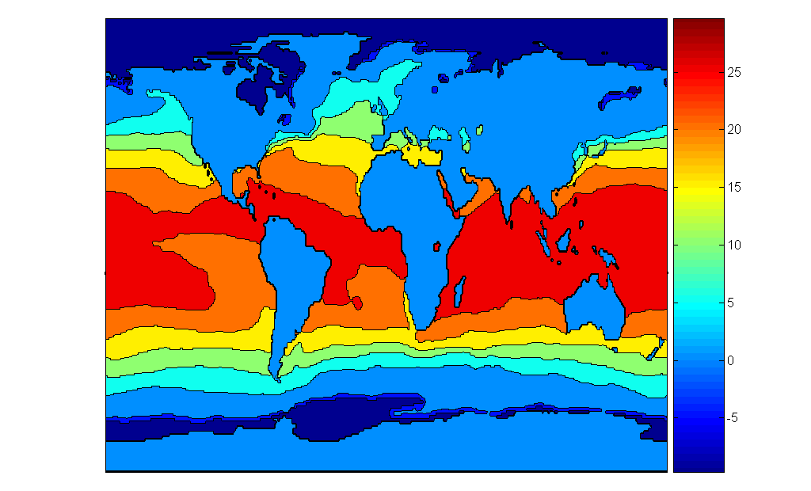
Contour Plot Example: Sea Surface Temperature (SST) Dec, 1998
Celsius

Slide 39
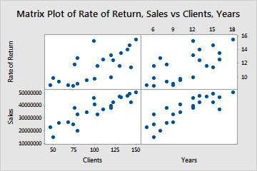
Visualization Techniques: Matrix plots / Scatterplot Matrices
Use Matrix Plot to assess the relationships between several pairs of variables at once. A matrix plot is an array of scatterplots.
This can be useful when objects are sorted according to class
Typically, the attributes are normalized to prevent one attribute from dominating the plot
Plots of similarity or distance matrices can also be useful for visualizing the relationships between objects
Notes:
https://support.minitab.com/en-us/minitab/18/help-and-how-to/graphs/how-to/matrix-plot/before-you-start/overview/
How to:

Slide 40
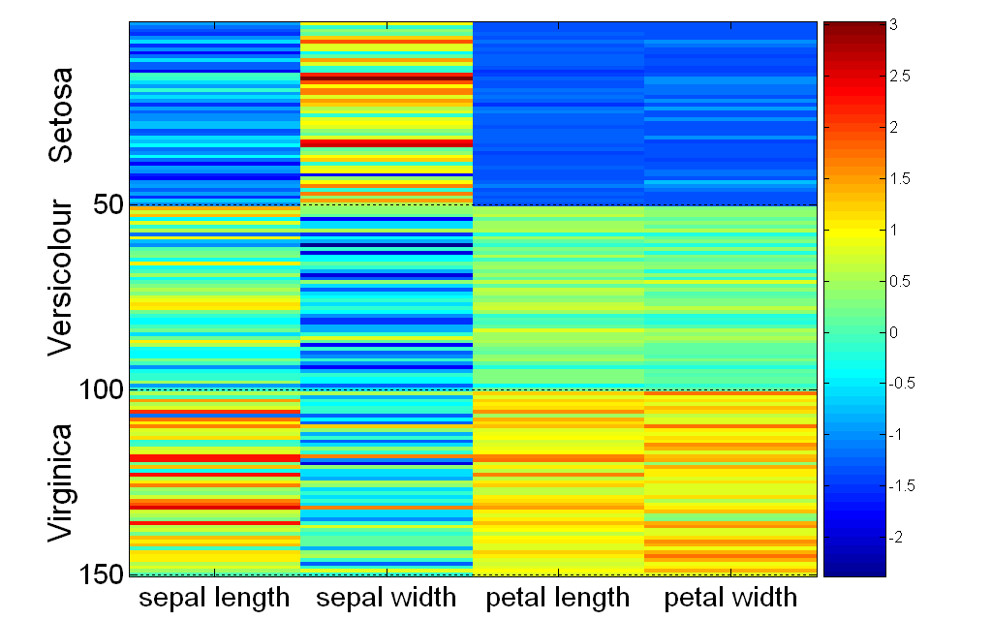
Visualization of the Iris Data Matrix
standard deviation

Slide 41
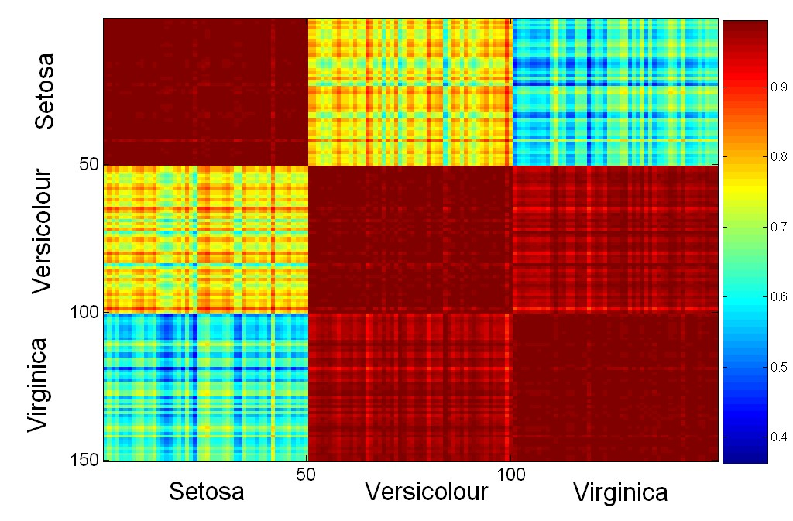
Visualization of the Iris Correlation Matrix

Slide 42
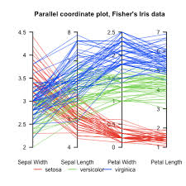
Visualization Techniques: Parallel Coordinates
Used to plot the attribute values of high-dimensional data (many features)
Instead of using perpendicular axes, use a set of parallel axes
The attribute values of each object are plotted as a point on each corresponding coordinate axis and the points are connected by a line
Thus, each object is represented as a line
Often, the lines representing a distinct class of objects group together, at least for some attributes
Ordering of attributes is important in seeing such groupings
Notes:
https://en.wikipedia.org/wiki/Parallel_coordinates
How to:

Slide 43
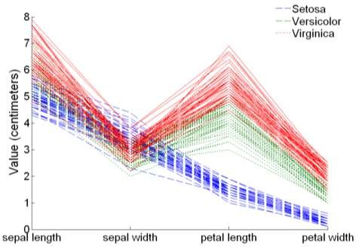
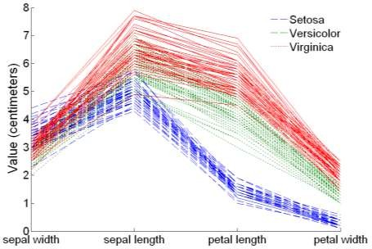
Parallel Coordinates Plots for Iris Data

Slide 44
Visualization Technique: Star Plots / Radar / Spider Chart
Similar approach to parallel coordinates, but axes radiate from a central point.
The line connecting the values of an object is a polygon.
Notes:
https://www.itl.nist.gov/div898/handbook/eda/section3/starplot.htm
https://en.wikipedia.org/wiki/Radar_chart
How to:
https://lx.iriss.org.uk/sites/default/files/resources/radar_chart_1.pdf

Slide 45
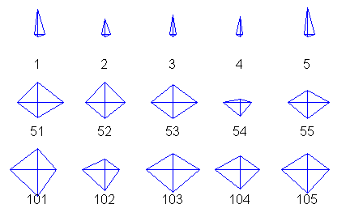
Star Plots for Iris Data
Setosa
Versicolour
Virginica

Slide 46
Chernoff Faces
Approach created by Herman Chernoff
This approach associates each attribute with a characteristic of a face
The values of each attribute determine the appearance of the corresponding facial characteristic
Each object becomes a separate face
Relies on human’s ability to distinguish faces
This example shows Chernoff faces for lawyers' ratings of twelve judges
Notes:
https://en.wikipedia.org/wiki/Chernoff_face

Slide 47
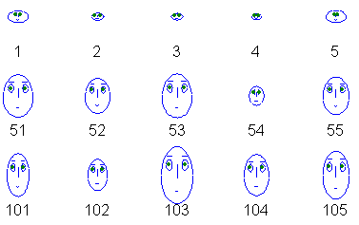
Chernoff Faces for Iris Data
Setosa
Versicolou
Virginica

Slide 48
Tools for Visual Plot
Microsoft Excel
SPSS
Python libraries (lab)
R libraries
Matlab
etc.

Slide 49
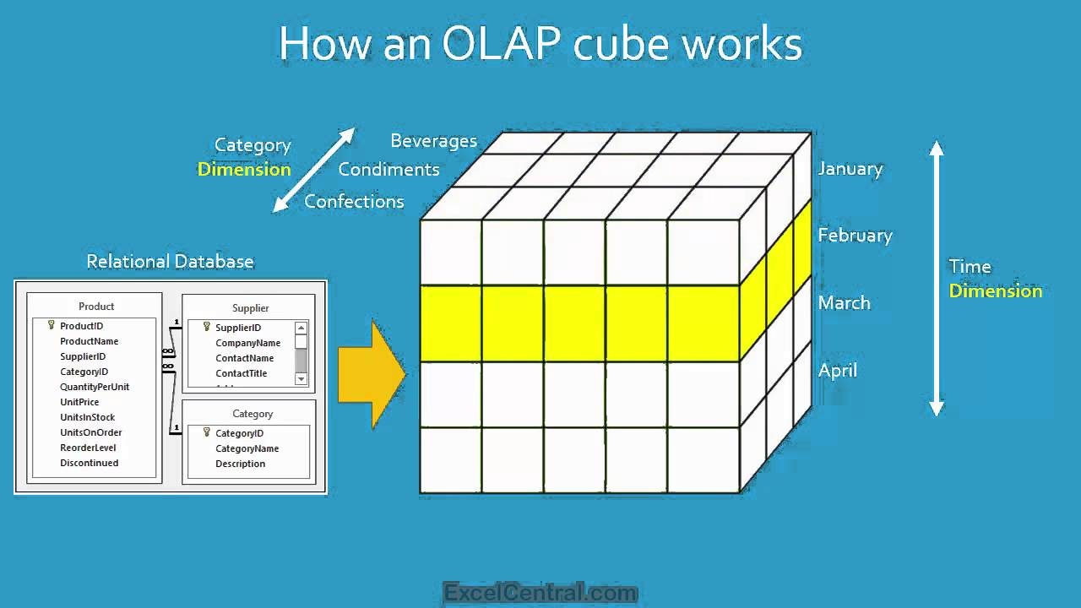
Online Analytical Processing (OLAP)
Online Analytical Processing (OLAP) was proposed by E. F. Codd, the father of the relational database.
Relational databases put data into tables, while OLAP uses a multidimensional array representation.
OLAP is an approach to answering multi-dimensional analytical (MDA) queries swiftly in computing.
There are a number of data analysis and data exploration operations that are easier with such a data representation.
Notes:
https://en.wikipedia.org/wiki/Online_analytical_processing

Slide 50
Creating a Multidimensional Array (1)
Two key steps in converting tabular data into a multidimensional array.
First, identify which attributes are to be the dimensions and which attribute is to be the target attribute whose values appear as entries in the multidimensional array.
The attributes used as dimensions must have discrete values
The target value is typically a count or continuous value, e.g., the cost of an item
Can have no target attribute at all except the count of objects that have the same set of attribute values
Notes:
How to:
http://olap.com/learn-bi-olap/tutorials/
https://www.tutorialspoint.com/dwh/dwh_olap.htm

Slide 51
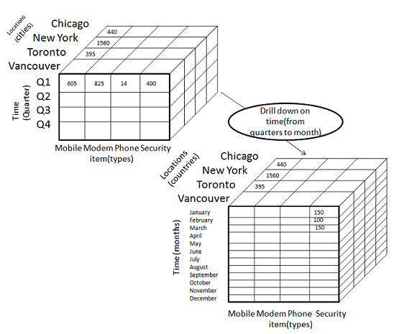
Creating a Multidimensional Array
Second, find the value of each entry in the multidimensional array by summing the values (of the target attribute) or count of all objects that have the attribute values corresponding to that entry.

Slide 52
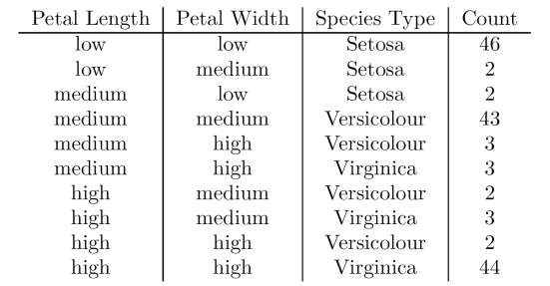
OLAP Example: Iris Data
We show how the attributes:
petal length, petal width, and species type
can be converted to a multidimensional array
First, we discretize the petal width and length to have categorical values:
low, medium, and high
Hence, we get the table in this slide.
Note the count attribute.
Notes:
https://www.guru99.com/online-analytical-processing.html

Slide 53
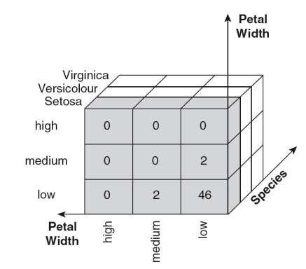
Example: Iris Data (continued)
Each unique tuple: (petal width, petal length, species type) identifies one element of the array.
This element is assigned thecorresponding count value.
The figure illustrates the result.
All non-specified tuples are 0.
Fill up the rest of the cube.

Slide 54
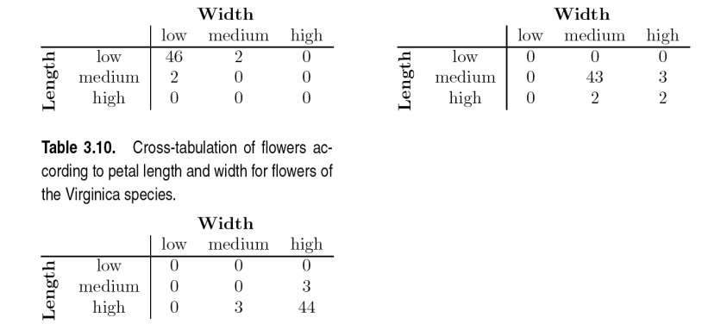
Example: Iris data (continued)
Slices of the multidimensional array are shown by the following cross-tabulations (each side of the cube).
What do these tables tell us?

Slide 55
Conclusion
In this chapter, we have learned about how to
produce descriptive / summary statistics about our dataset
perform dimensionality reduction techniques to avoid curse of dimensionality
visualize data using techniques such as
Histogram
Box Plot
Scatter Plot
Contour Plot
etc.

Slide 56
References
Main References:
Russell, S.J. & Norvig, P. (2009) Artificial Intelligence: a modern approach. (3rd ed.). Prentice Hall.
Additional References:
Negnevitsky, M. (2011) Artificial intelligence: a guide to intelligent systems. (3rd ed.). Addison Wesley.
Engelbrecht, A. P. (2007) Computational intelligence: an introduction. (2nd ed.). Wiley.

